Slide 1
AME20216 - Lab I Discrete Probability Distributions

Slide 2

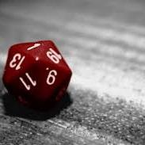
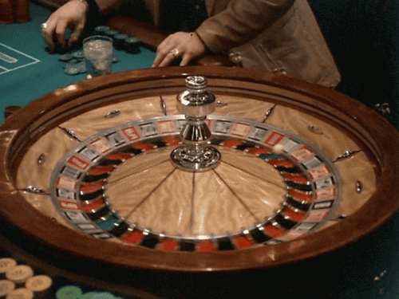

Unpredictable Systems

Slide 3
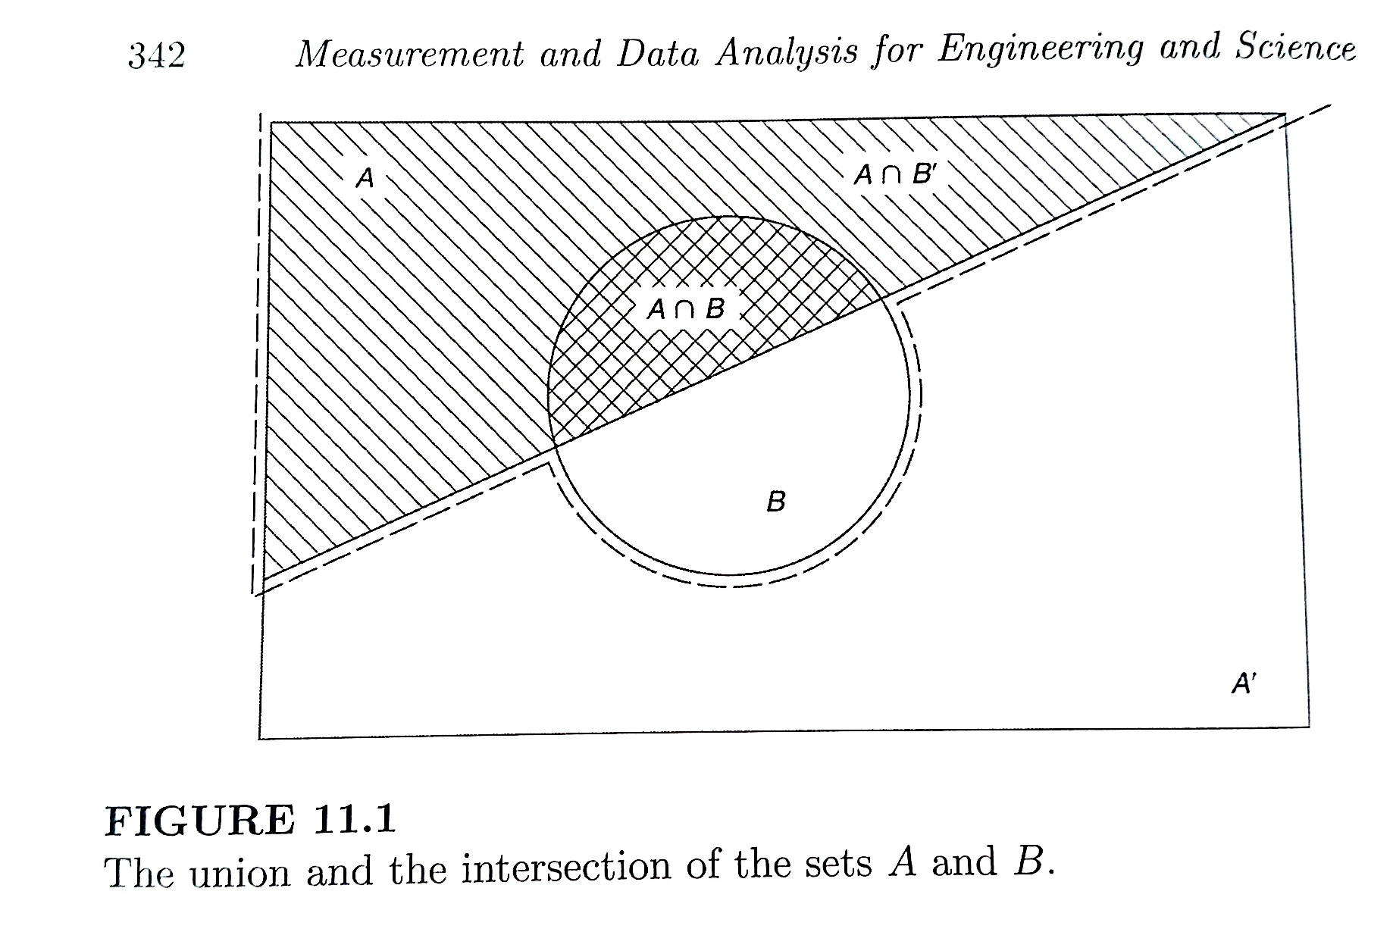
Probability – Venn Diagrams
Intersection “AND”
Union “OR”

Slide 4

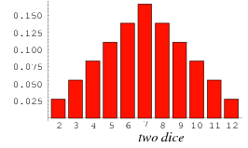
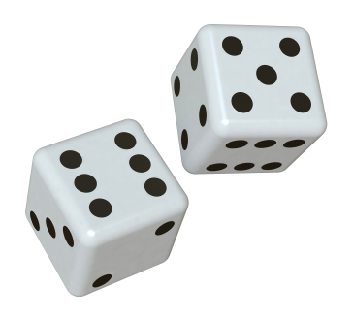
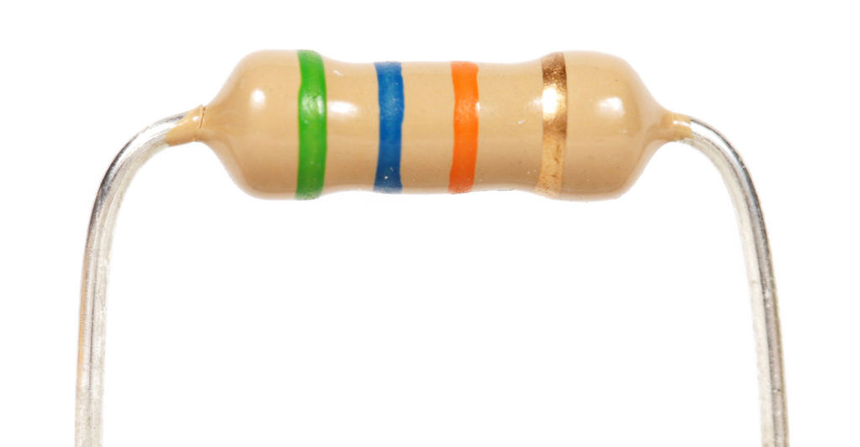
A12 – Monte Carlo Night!
Pair of Dice
Manufactured Resistors

Slide 5
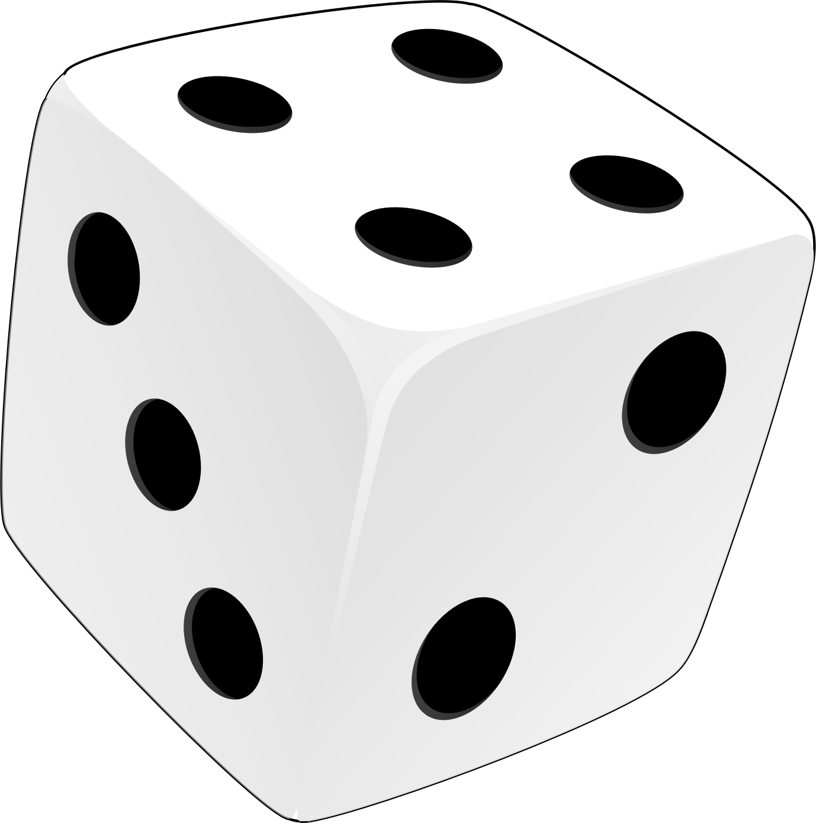
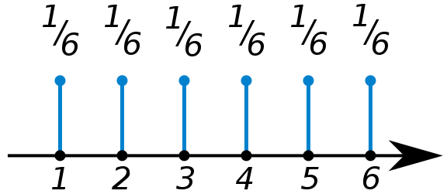
Discrete Probability Distributions
P(n) – Probability of observing the nth discrete value
P(n) =
n =
Normalization
Mean or “expected value”
<n> = 3.5

Slide 6
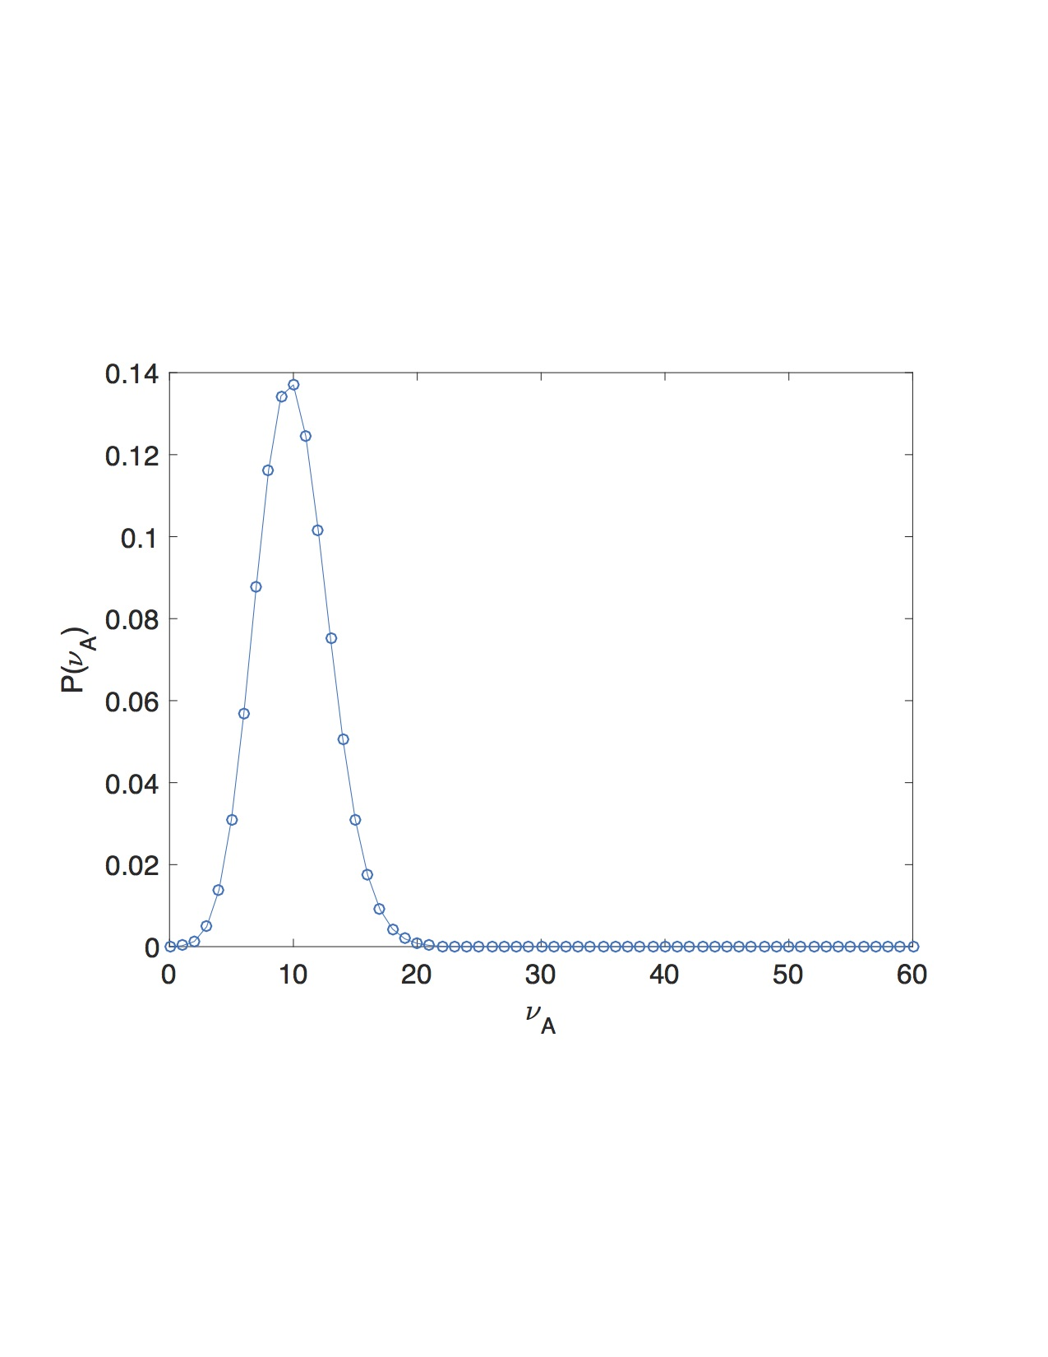
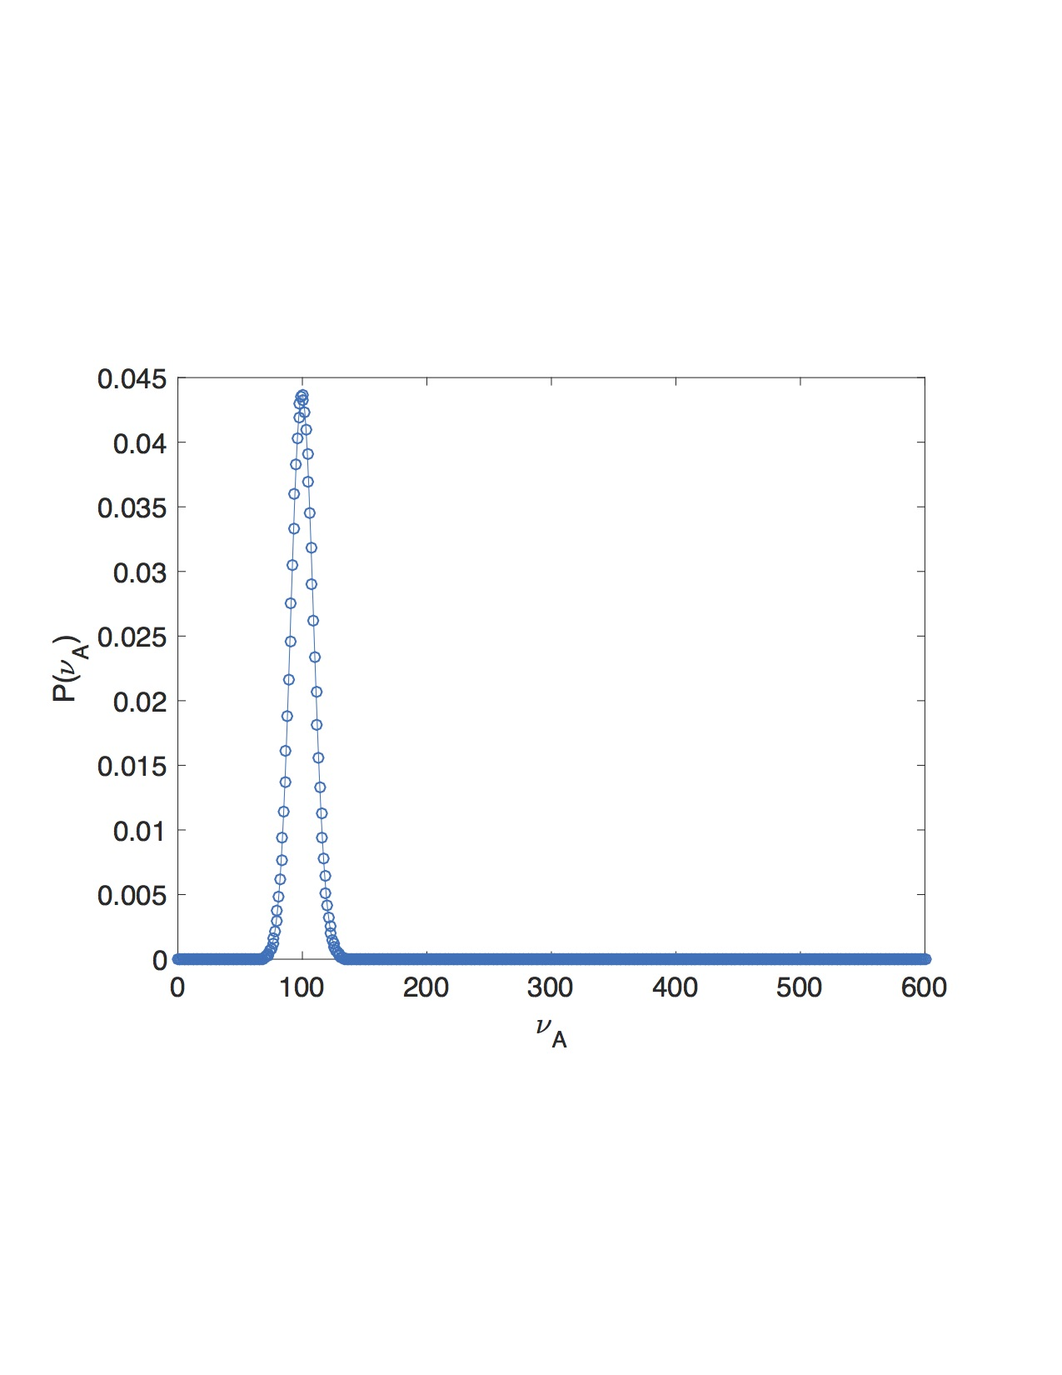
Binomial Distribution
Probability an event A occurs v_{A} times out of N trials, given the prob. of seeing it once is P(A).
N= 600
N= 60
P(A)=1/6
P(A)=1/6

Slide 7
Measuring Probability – Poisson Statistics
“Counting” experiments.
Uncertainty in Measured Probability
Measured Probability
N= 600
N= 60
P(A)=1/6
P(A)=1/6
“Statistical Convergence”

Slide 8


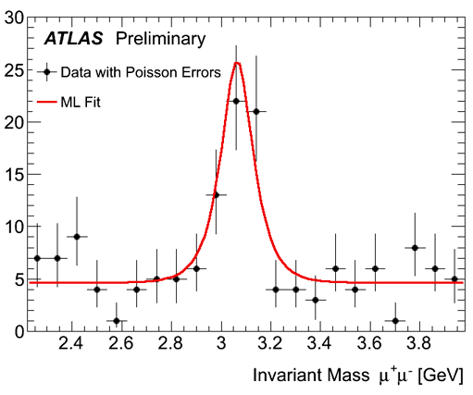
Measuring Probability – Poisson Statistics
“Counting” experiments.
http://www.bbc.com/news/world-us-canada-43818752

